Slide 1
Drivers of Natural Gas Prices In The United States
Group Members:
Wilson Aliaga
Carlton Lewis
Velmarini Vasquez

Slide 2
Project Questions
Supply Drivers questions:
How does production vary over time in different counties with natural gas reserves?
How does storage change over time based on the facilities (e.g. pipelines) available in the regions with natural gas reserves?
How does imported gas contribute to the supply over time?
Demand Drivers questions:
How do temperature changes affect gas demand?
How does economic growth influence gas consumption?

Slide 3
Data Set Sources
U.S. Energy Information Administration (EIA)
World Weather
Federal Reserve Economic Data (FRED)
U.S. Census Database

Slide 4
Data Exploration
Demand
Obtain and analyze the following data:
Residential consumption over time
Industrial consumption over time
Commercial consumption over time
Exports over time
Supply
Obtain and analyze the following data:
Production over time
Reserve changes over time
Capacity and storage use of each state of the country overtime, and the create a time dependent Google Heat Map
Imports over time
Pipelines and liquid natural gas (LNG) terminals

Slide 5
Data
Sources | Extraction | Cleaning | Analysis Methods
EIA | API Key JSON Excel Files | Excel files conversion into Pandas Data Frames
World Weather
Google Maps Platform
FRED
Census

Slide 6
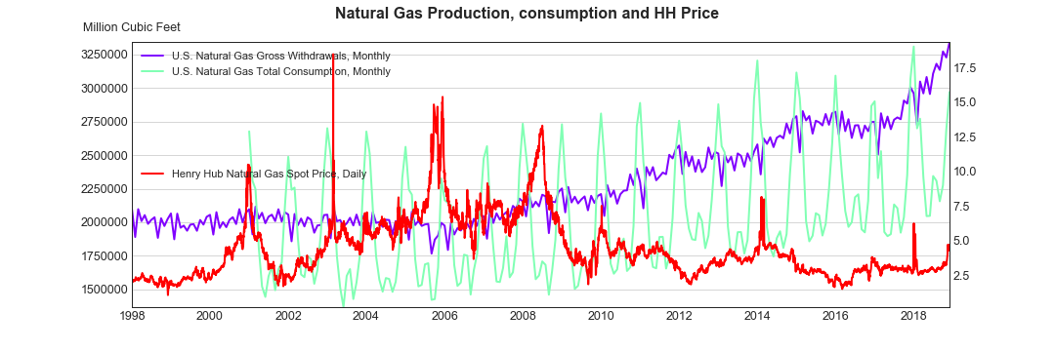
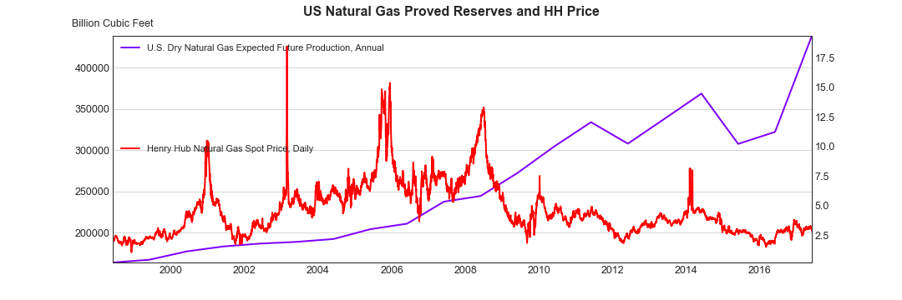

Slide 7
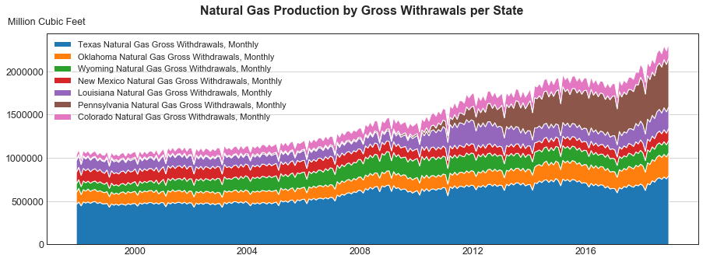

Slide 8
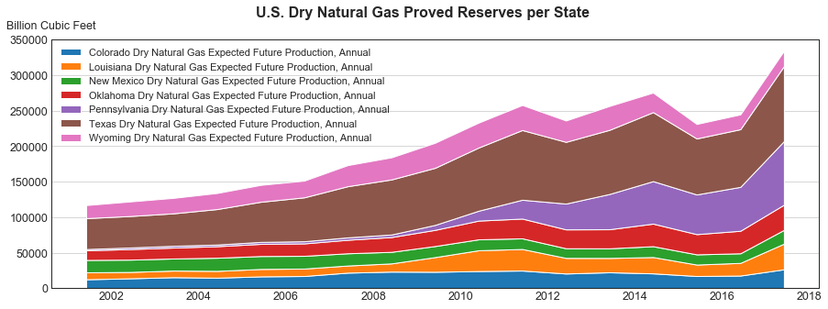

Slide 9
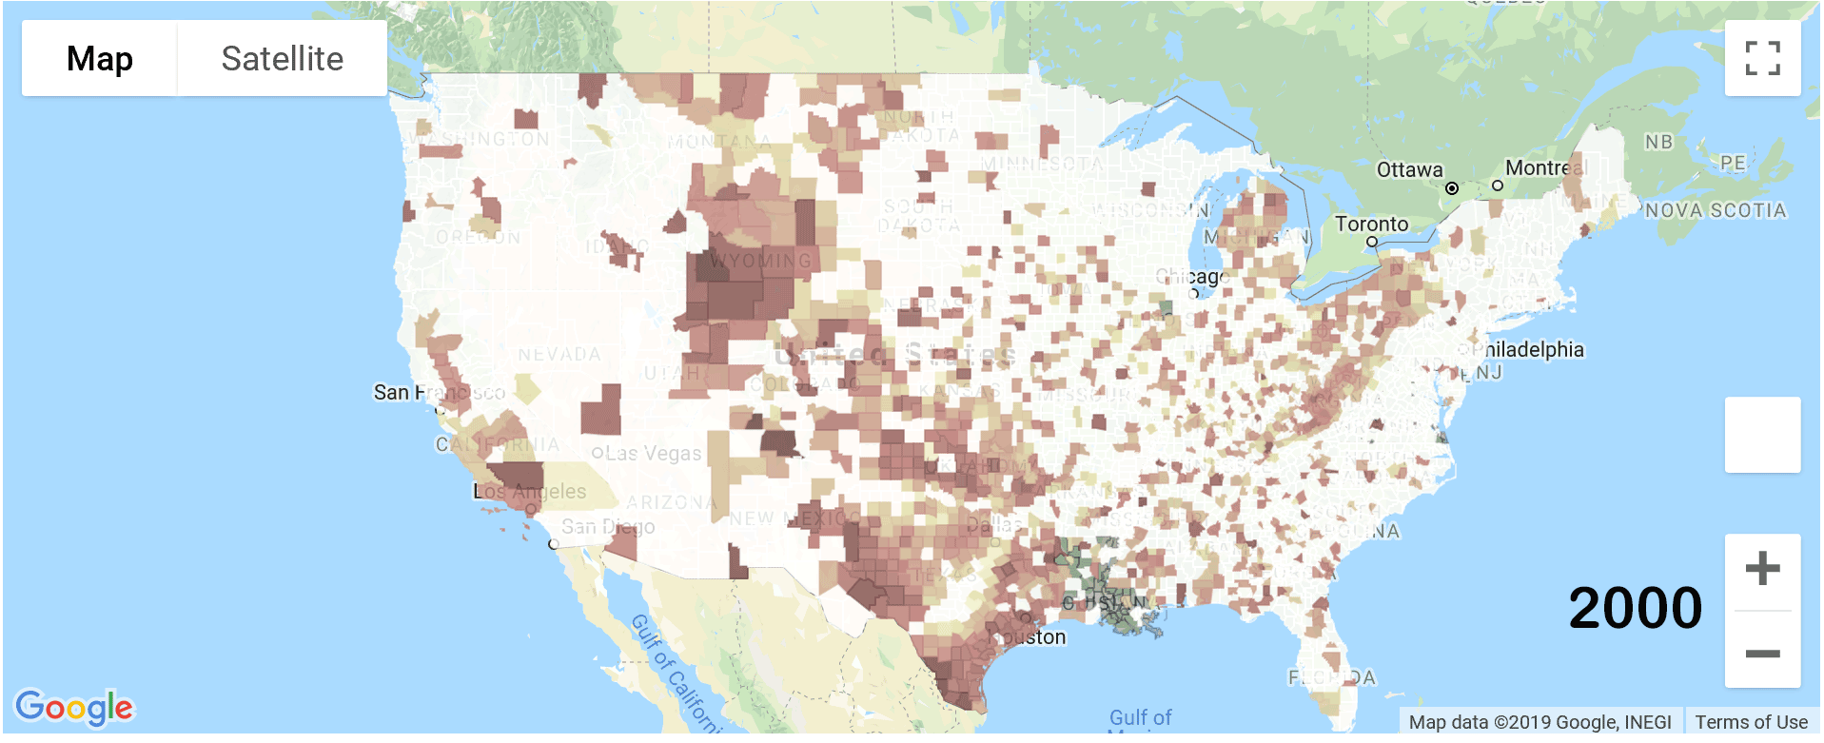

Slide 10
Analysis Process
The data exploration and cleanup process (accompanied by your Jupyter Notebook)

Slide 11
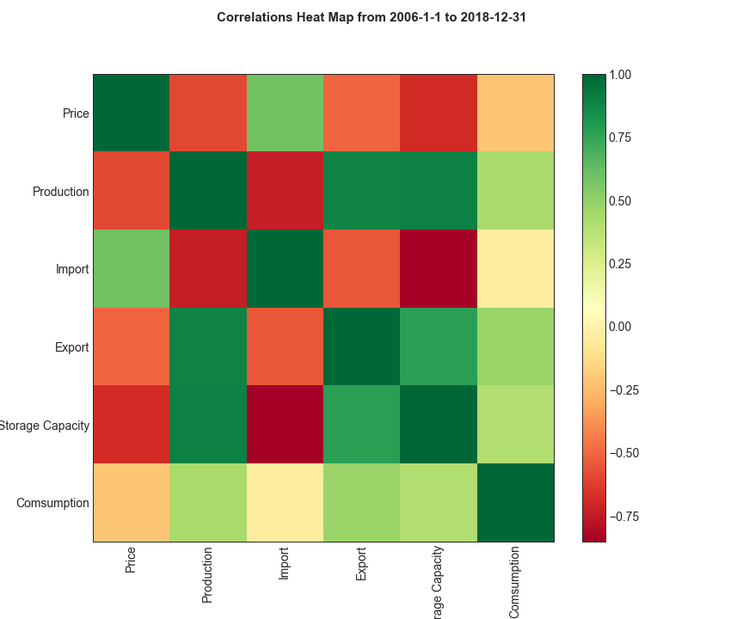

Slide 12
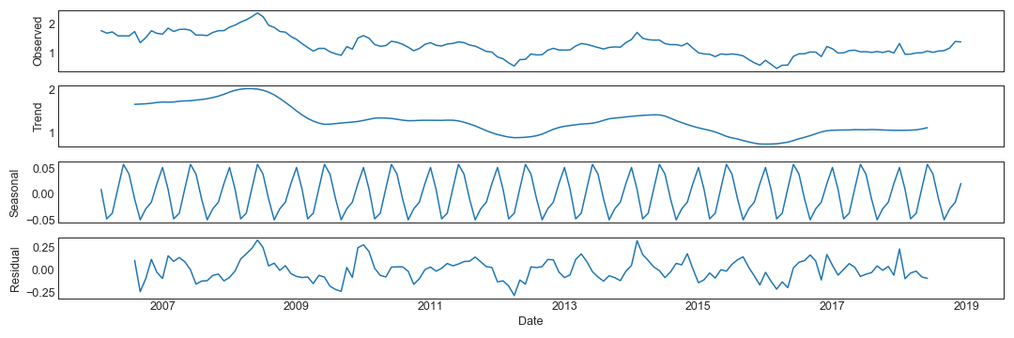

Slide 13
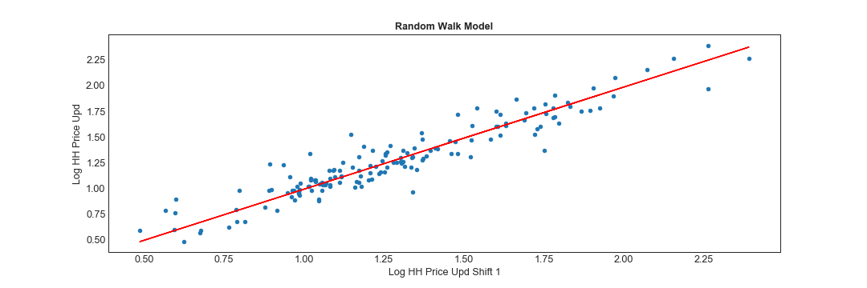
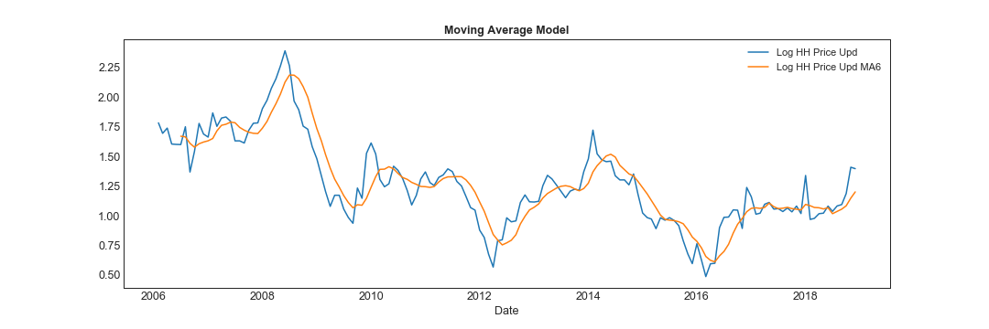

Slide 14
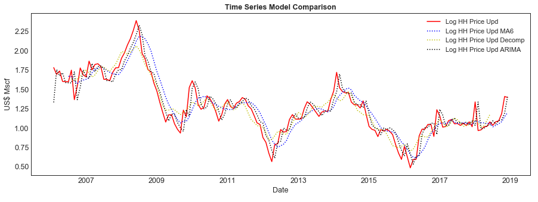

Slide 15
conclusions
This should include a numerical summary as well as visualizations of that summary.

Slide 16
implications of the findings
This is where you get to have an open-ended discussion about what your findings "mean".

